Slide 1

SMART INDIA HACKATHON 2026
TITLE PAGE
Problem Statement ID –SIH26007
Problem Statement Title-Safe and Efficient Operation of Mine Vehicles in Fog and Low-Visibility Conditions in Open Cast Iron Ore Mines.
Theme-Smart Automation
PS Category- Hardware
Team ID-140880
Team Name - SILICON SAVANTS123

Slide 2
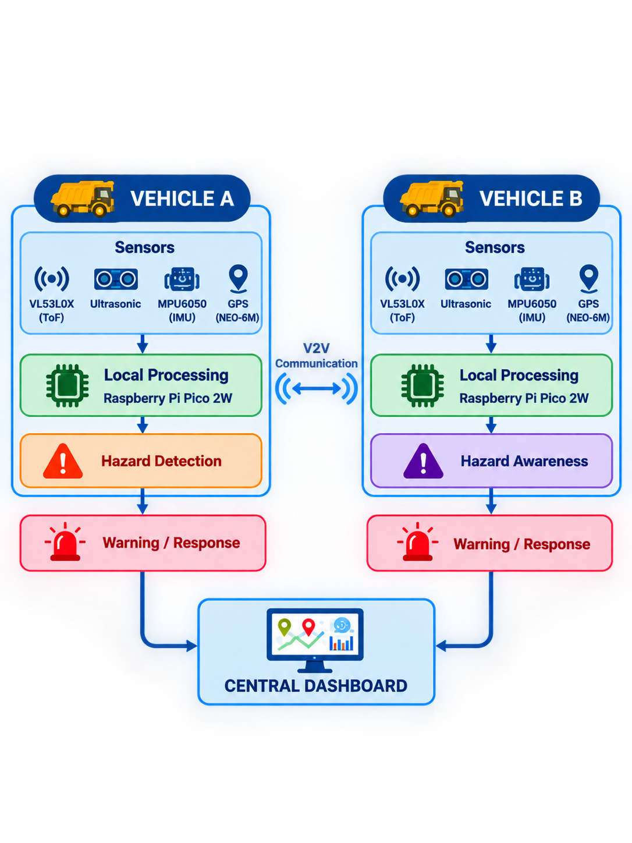
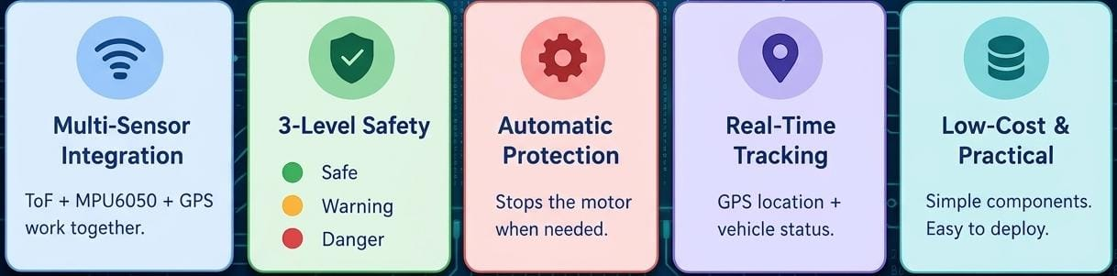
Safe and Efficient Operation of Mine Vehicles in Fog and
Low-Visibility Conditions in Open Cast Iron Ore Mines.
SILICON SAVANTS123
Proposed Solution:
Real World Problem : Low visibility in open-cast mines makes it difficult for dumper operators to detect vehicles and obstacles, increasing collision risk and causing operational delays
1.Detect nearby vehicles and obstacles using multiple sensors.
2. Monitor
Track vehicle position, movement and operating status.
3. Communicate
Exchange vehicle status and hazard information through V2V communication.
4. Assess Risk
Combine distance, motion and vehicle information to identify collision risk.
5. Alert & Respond
Warn the driver and initiate controlled slowing/stopping when required.
6. Monitor Fleet
Display vehicle status and hazards on a centralized dashboard.
Core Challenges:
🌫️ Poor Visibility — Fog, dust and rain limit visibility.
🚛 Dumper Blind Spots — Nearby vehicles and obstacles can go undetected.
📡 No Real-Time Coordination —Limited sharing of vehicle location and hazards.

Slide 3
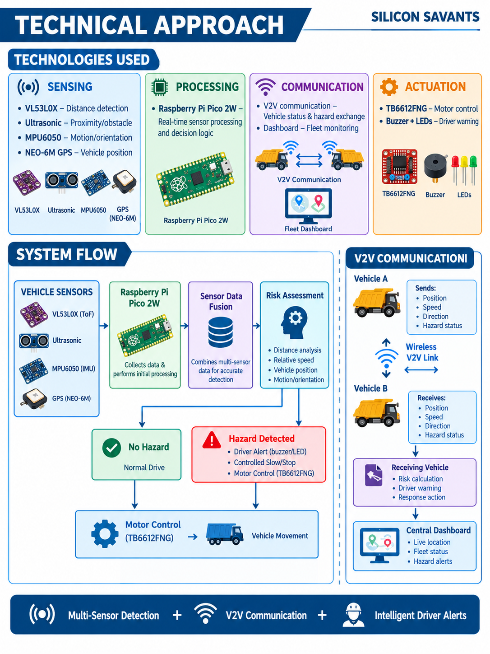
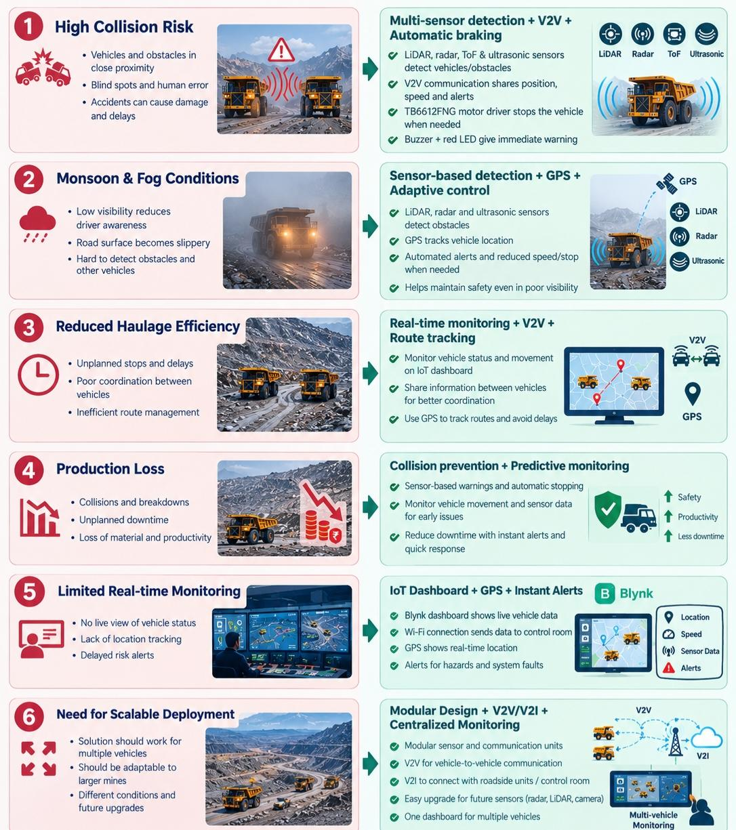
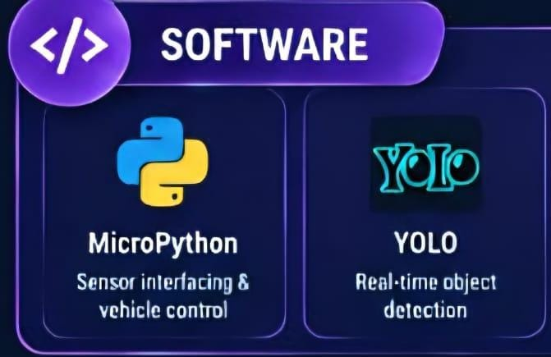
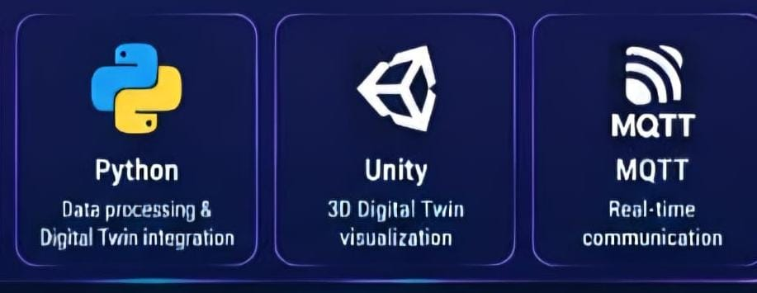
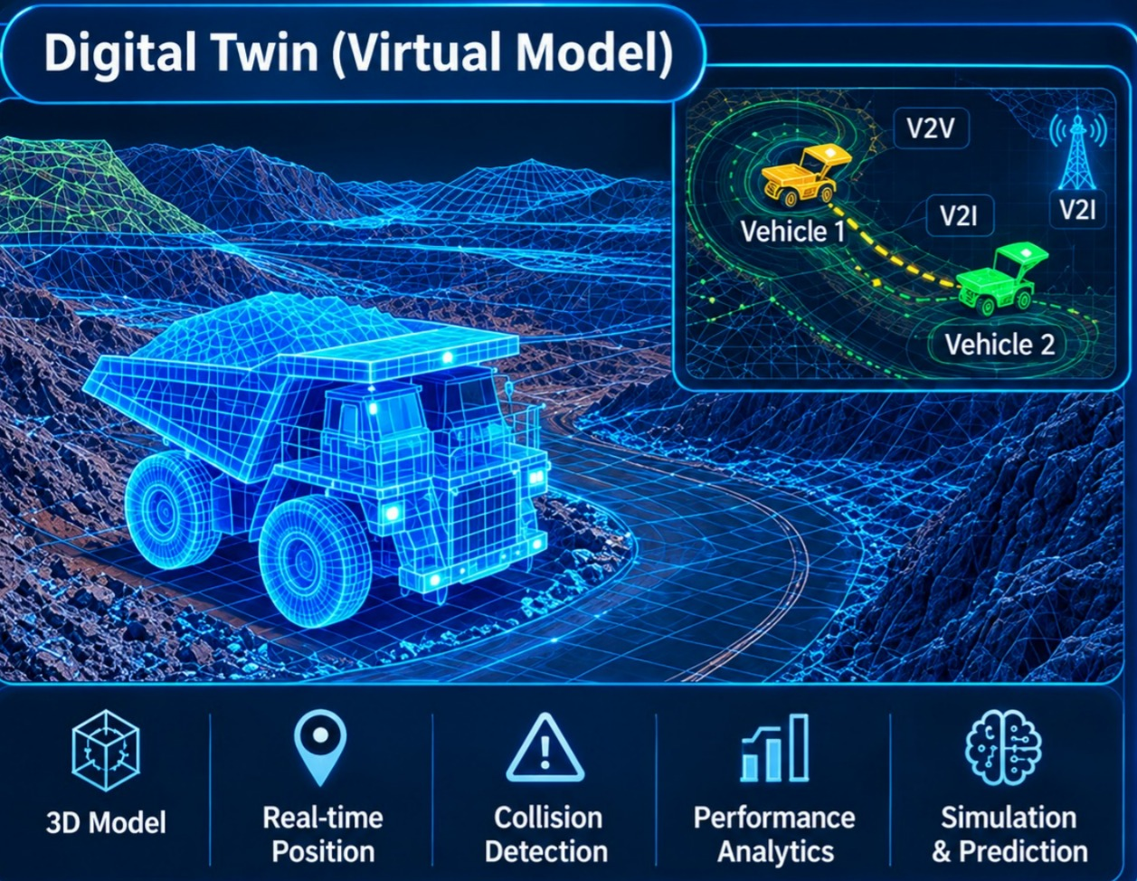
TECHNICAL APPROACH
SILICON
SAVANTS123
TECHNICAL APPROACH
CHALLENGES
OUR APPROACH
Technologies Used:

Slide 4
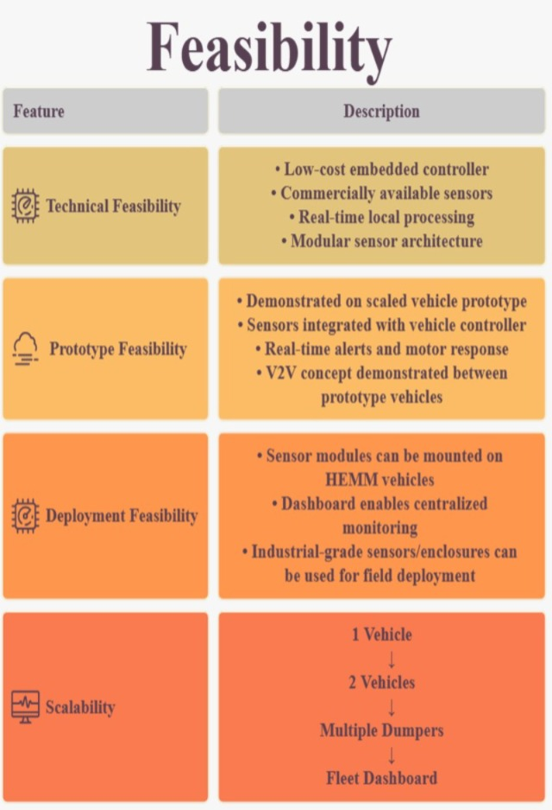
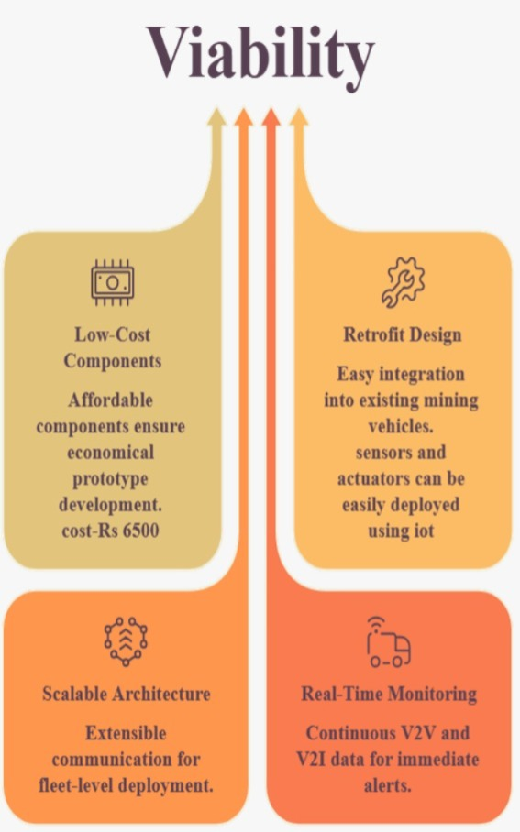
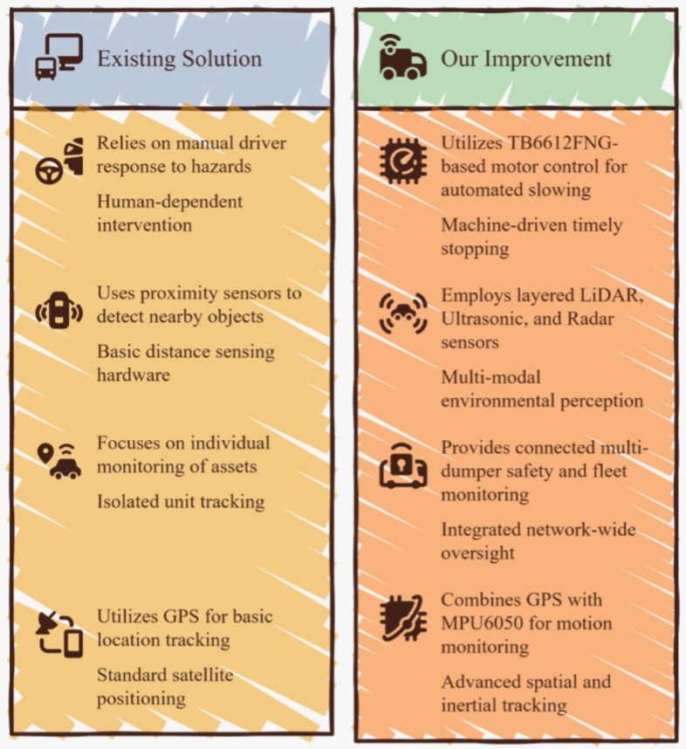
FEASIBILITY AND VIABILITY
SILICON
SAVANTS123

Slide 5
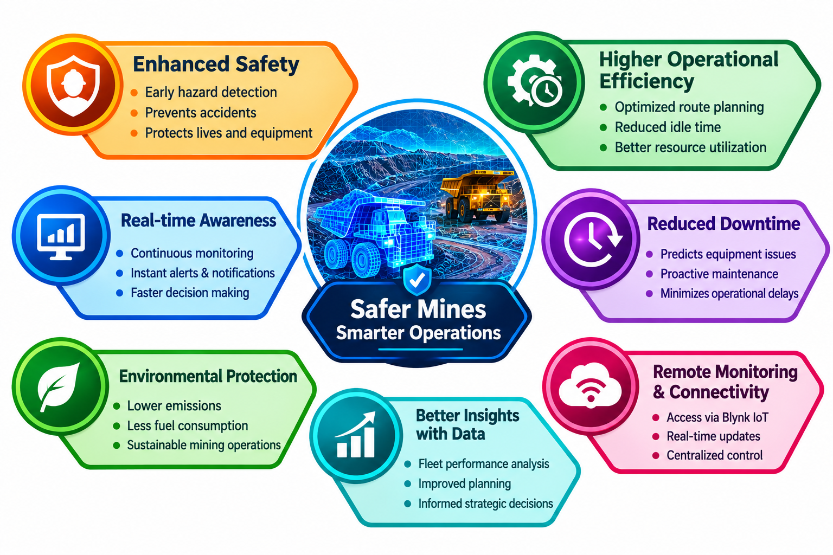
IMPACT AND BENEFITS
SILICON
SAVANTS123
IMPACT
BENEFITS
Improved Safety –Earlier warning of nearby vehicles and obstacles
Reduced collision exposure in low visibility.
Better Fleet Coordination – V2V communication improves awareness between dumpers
Improved haul-road coordination.
Faster Response – Supports timely stopping during critical situations.
Early Hazard Detection – Gives operators timely warnings about nearby vehicles and obstacles.
https://youtu.be/AJcr9JlmeS8?si=hzy0yNTxMBC2BrFL
Business Opportunity: Commercialize the system for mining companies through hardware sales, installation, and subscription-based fleet monitoring.

Slide 6
RESEARCH AND REFERENCES
SILICON SAVANTS123
Hardware Datasheet
Communication Research
https://pip-assets.raspberrypi.com/categories/1088-raspberry-pi-pico-2-w/documents/RP-008304-DS-3-pico-2-w-datasheet.pdf
https://www.slideshare.net/slideshow/v2v-vehicle-to-vehicle-communication/236599683
Rasberry pi pico data sheet
V2V Communication
Vl53l0x datasheet
https://cdn-learn.adafruit.com/downloads/pdf/adafruit-vl53l0x-micro-lidar-distance-sensor-breakout.pdf
https://www.3mindia.in/3M/en_IN/road-safety-in/resources/road-transportation-safety-center-blog/full-story/~/what-is-vehicle-to-infrastructure-v2i-communication-and-why-do-we-need-it/?storyid=0b95359f-9389-4233-9db4-63e307d36b70
V2I Communication
Tb6612fng
datasheet
https://cdn.sparkfun.com/datasheets/Robotics/TB6612FNG.pdf
Safety Research
Hazards in Mining and How to Prevent Them
https://fatfinger.io/collision-hazards-in-mining/
Mine area fatal Survey
https://factly.in/tracking-fatal-and-serious-accidents-in-indias-mines/

